Slide 1
Lecture 11
Covariance and correlation
The Sample Mean

Slide 2







Covariance and Correlation
Covariance: measure the association between two random variables.
Let X and Y be random variables having a specified joint distribution, and let E(X)= , E(Y)= ,
Var(X)= , Var(Y)= . The covariance of X and Y, is defined as
  If , , then Cov(X,Y) will be finite.
  Cov(X,Y) can be positive, negative, or zero.

Slide 3


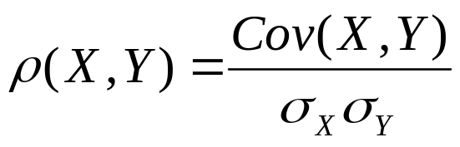

Correlation
If , , the correlation of X and Y, is defined as
The range of possible values of the correlation is:

Slide 4





Theorem (Schwarz inequality): For any random variables U and V,
Proof. (a) If , then Pr(U=0)=1. It follows that Pr(UV=0)=1. So E(UV)=0 and the relation is satisfied. If , the relation is also satisfied.
(b) If either or is infinite, apparently the relation is satisfied.

Slide 5


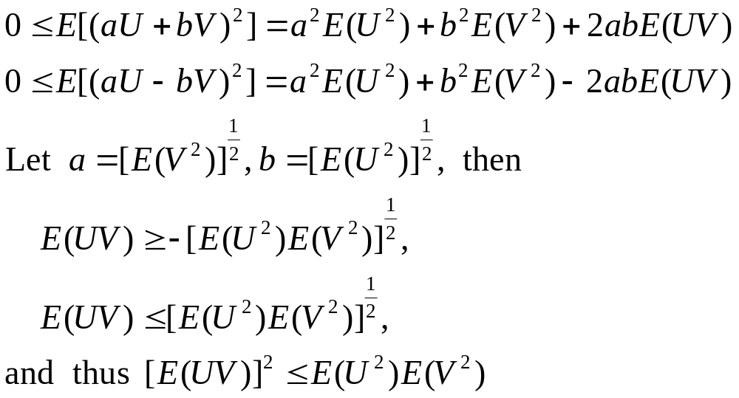
(c) If ,

Slide 6

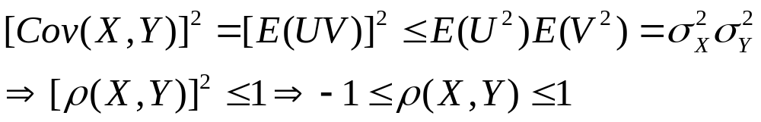



Let , then
X and Y are positively correlated:
X and Y are negatively correlated:
X and Y are uncorrelated:

Slide 7
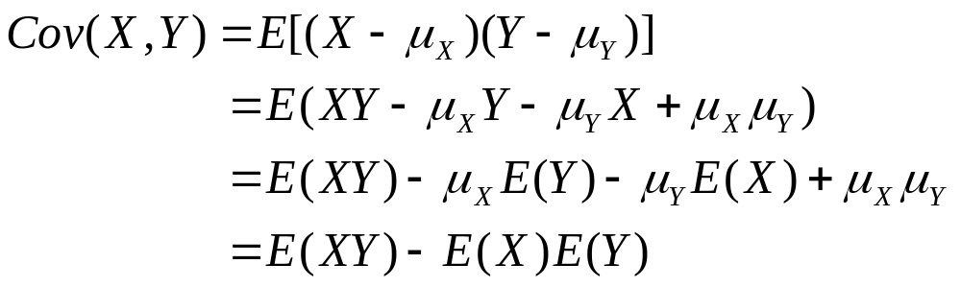
Properties of Covariance and Correlation
Theorem. For any random variables X and Y such that and ,
Cov(X,Y)=E(XY)-E(X)E(Y)
Proof.

Slide 8

Theorem. If X and Y are independent random variables with and
, then
Proof. If X and Y are independent, then E(XY)=E(X)E(Y). Therefore,
Cov(X,Y)=E(XY)-E(X)E(Y)=0.
It follows that

Slide 9

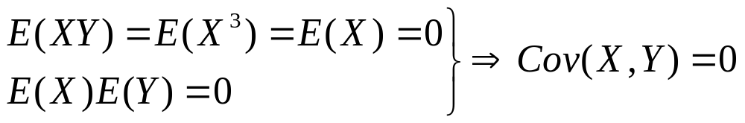
Remark: Two uncorrelated random variables can be dependent.
Example 4.6.3. Suppose that X can take only three values –1, 0, and 1 and each of these three values has the same probability. Let Y be defined by . We shall show that X and Y are dependent but uncorrelated.
Proof. Apparently X and Y are dependent.
X and Y are uncorrelated.

Slide 10






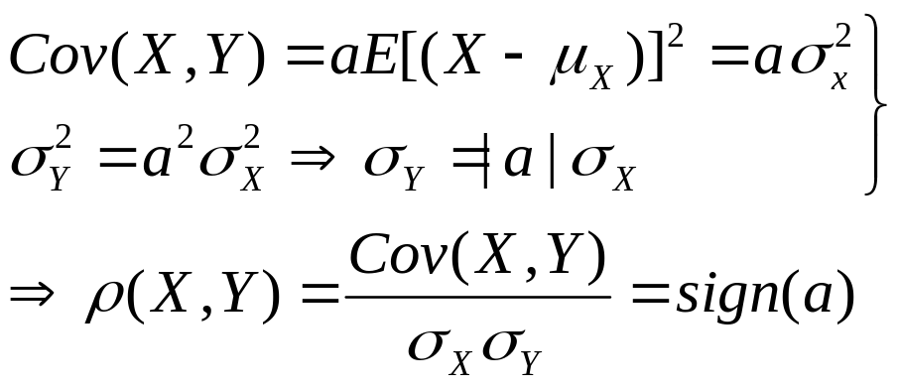
Theorem. Suppose X is a random variable with , suppose that Y=aX+b where
. If a>0, then . If a<0, then
Proof. If Y=aX+b, then and
. Therefore,

Slide 11


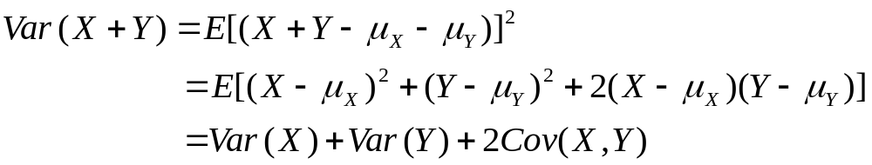
Theorem. If X and Y are random variables such that and , then
Var(X+Y)=Var(X)+Var(Y)+2Cov(X,Y).
Proof. Since E(X+Y)= , then

Slide 12
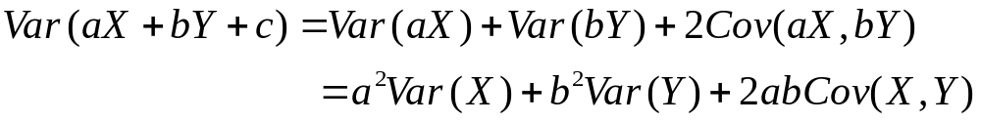
Remark. For any constants a and b, we can show that Cov(aX,bY)=abCov(X,Y). It follows that

Slide 13

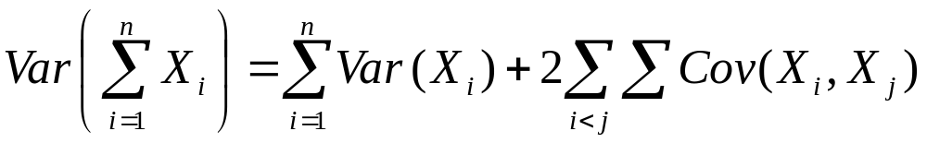
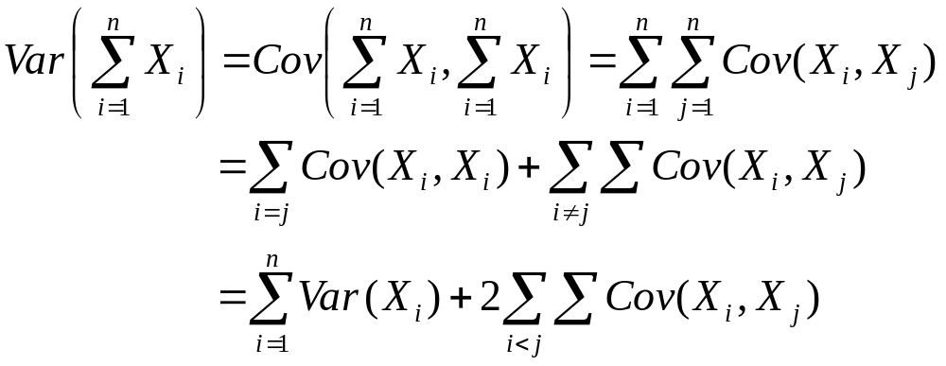
Theorem. If X1,...,Xn are random variables such that for i=1,...,n, then
Proof. For any random variable Y, Cov(Y,Y)=Var(Y).

Slide 14
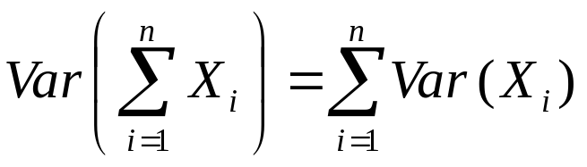
Remark. If X1,...,Xn are uncorrelated random variables, then

Slide 15

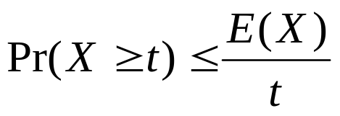
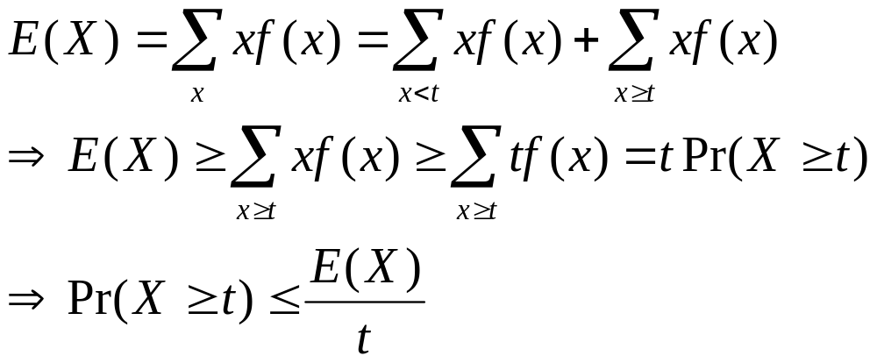
The Sample Mean
Theorem. Markov Inequality. Suppose that X is a random variable such that . Then for any given number t>0,
Proof. Assume for convenience that X has a discreate distribution with p.f. f. Then,

Slide 16

Remark. The Markov inequality is primarily of interest for large values of t. For example, for any nonnegative random variable X whose mean is 1, the maximum possible value of is 0.01.

Slide 17
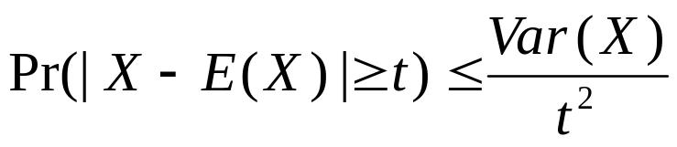


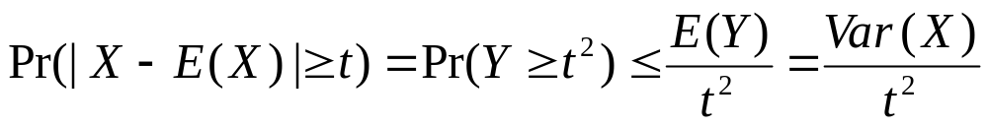
Theorem 4.8.2. Chebyshev Inequality. Let X be a random variable for which Var(X) exisits. Then for any given number t>0,
Proof. Let . Then and E(Y)=Var(X). By applying the Markov inequality to Y, we have

Slide 18

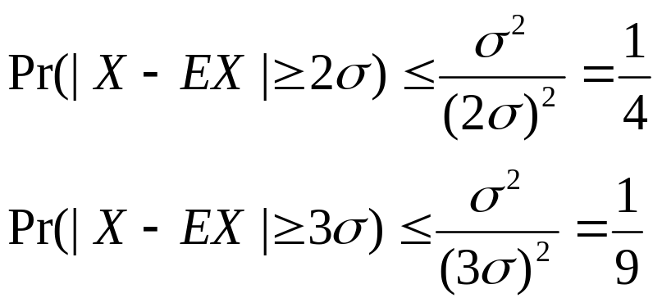
Remark. Suppose Var(X)=

Slide 19

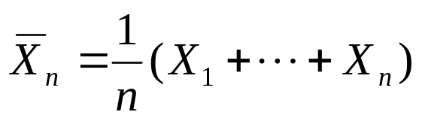
Properties of the Sample Mean
Suppose that X1,...,Xn form a random sample of size n from some distribution for which the mean is and the variance is . Let
This random variable is called the sample mean.

Slide 20
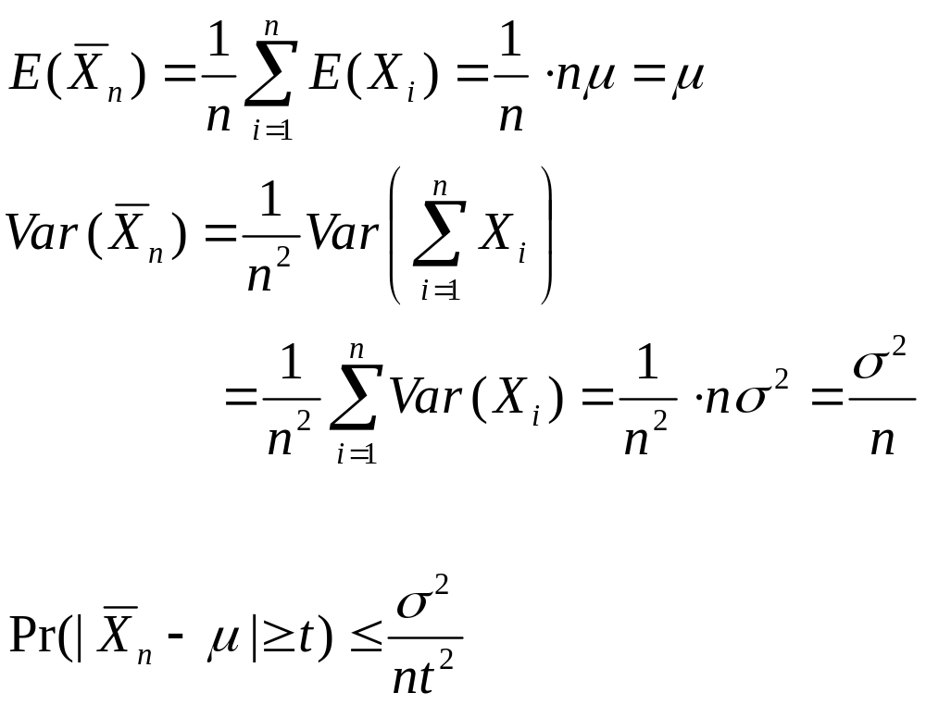

Slide 21

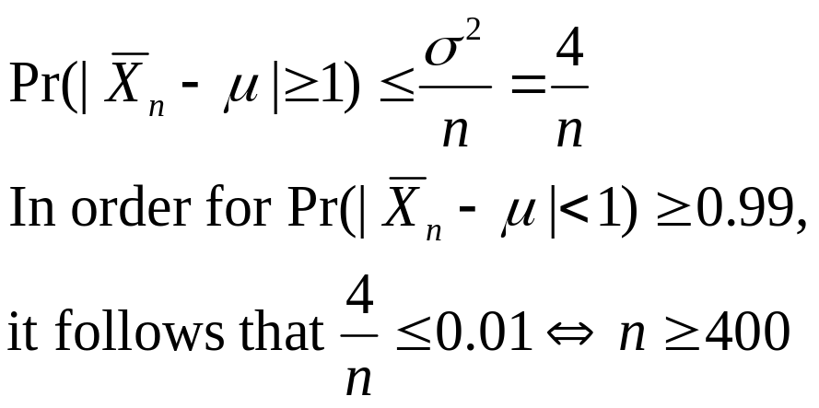
Example 4.8.1
Suppose a random sample is to be taken from a distribution for which the mean is unknown, but the standard deviation is known to be 2. How large a sample must be taken in order to make the probability at least 0.99 that will be less than 1 units.

Slide 22

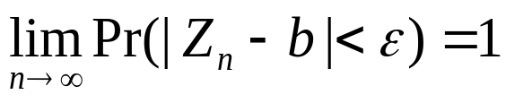
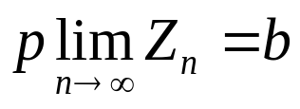

The Law of Large Numbers
Convergence in Probability. Suppose Z1,Z2,... is a sequence of random variables. It is said that this sequence converges to a given number b in probability if for any given number ,
This is represented by
or

Slide 23

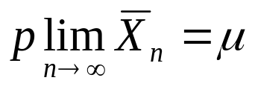
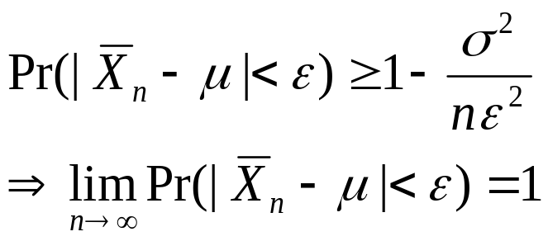
Law of large numbers. Suppose that X1,...,Xn form a random sample from a distribution for which the mean is , and let denote the sample mean. Then
Proof. Assume the distribution from which the random sample is taken has a finite variance . From the Chebyshev inequality, for any ,

Slide 24
Remark. If a large random sample is taken from a distribution for which the mean is unknown, then the arithmetic average of the values in the sample will usually be a close estimate of the unknown mean.

Slide 25



Continuous Functions of Random Variables
If , and if g(z) is a function that is continuous at z=b, then
If and , and if g(z,y) is continuous at (z,y)=(b,c), then

